Slide 1
COMP 3100
Week 4 - Wednesday

Slide 2
Last time
What did we talk about last time?
Agile
Started Scrum

Slide 3
Questions?

Slide 4
Back to Scrum

Slide 5
User stories
We mentioned user stories in the discussion about requirements
User stories are the most popular way of specifying features in Scrum
User story format:
  As a <user role> I want to <goal> so that <benefit>.
Examples:
  As a course scheduler I want to determine whether students can take other sections of a course so that I can see if I can cancel a section with students already enrolled in it.
  As a shopper I want to see whether an item is still on sale so that I can buy it more cheaply.
  As an internet user I want to secure my devices so that I can protect my private information.
  As an electric utility customer I want to see my usage over several years so that I can analyze it to budget my electricity costs more exactly.

Slide 6
User story abstraction
User stories come at different levels of abstraction and size
  Large, abstract stories that would take months of coding are sometimes called epics
  Medium-sized stories that would take several sprints are sometimes called features
  Small, detailed stories that can be done in a single sprint are sprintable stories (or simply stories)
Even sprintable stories usually aren't detailed enough to implement without additional conversations with stakeholders

Slide 7
PBI priorities
In addition to the specification of functionality, every PBI should have a priority
Priorities express how important the PBI is and can be expressed as a number or a rubric (low, medium, high, critical)
The PO sets the priorities based on stakeholder feedback
Dependencies also determine priorities: If X is needed for Y, then the priority of X must be at least as high as Y
High-priority PBIs should be small enough to do in a single sprint

Slide 8
PBI effort estimates
Each PBI must have an effort estimate
High-priority, sprintable PBIs need precise estimates (such as person-days), to aid in sprint planning
Low-priority, abstract PBIs are further from sprintable status and only need rough estimates (small, medium, large, gigantic)
As PBIs are refined, their effort estimates need to become more precise

Slide 9
PBI acceptance criteria
How do we know when a PBI is done?
Acceptance criteria are checks a user can do to see if a PBI is finished and correct
Often, these form a test suite used by developers
Following the same pattern of steady refinement, high-priority PBIs should have detailed acceptance criteria
  These acceptance criteria might be further refined during the sprint

Slide 10
Product backlog refinement
Refining or grooming the product backlog means:
  Adding, removing, or modifying PBIs
  Making PBIs nearing the top of the product backlog more detailed
  Re-estimating and re-prioritizing PBIs
  Adding acceptance criteria to PBIs
Refinement happens during sprint review
It should happen at least once during a sprint to make sure there are enough sprintable stories for the next sprint
A PO can use a spreadsheet to manage the product backlog, but there are also specialized tools

Slide 11
Estimating work and timeline
Two pieces of information are needed: The size of the job and the speed of the team
PBIs are estimated by story points or ideal hours
One or two story points is supposed to be how much effort the smallest stories take
  Bigger stories are estimated relative to that size
An ideal hour or a person hour is the amount an average developer can accomplish in one uninterrupted hour of work
Story points are more commonly used, since they're easier to estimate

Slide 12
Velocity
Velocity is the amount of work done per sprint
After a sprint, story points or ideal hours can be added up to see how much got done
Past velocities can be used as a guide for how many story points can get done when planning the next sprint
Ideally, tracking this information will help get better estimates of story points and ideal hours for other stories and also a better estimate of team velocity

Slide 13
Creating the sprint backlog
In sprint planning, teams refine their estimates of high-priority PBIs before finalizing the sprint backlog
For each PBI, they estimate the tasks involved in ideal hours
  Story points can be used, but ideal hours are more precise
The tasks can include:
  Coding
  Unit testing
  Integration testing
  Acceptance testing
  Code inspection
  Updating user documentation
The final sprint backlog includes PBIs, their constituent tasks, and effort estimates for all tasks

Slide 14
Sprinting
Sprinting is actually doing the implementation
Sprinting is considered a time-boxing technique, where the amount of work done is based on the time available
  Rather than letting time expand as needed to finish a task
For a given project (and at a given company) sprints are usually the same length, somewhere between a week and a month
Short, consistent sprints are easier to plan and track and give rapid feedback
If PBIs can't be finished during a sprint, they go back on the product backlog
If a team finishes all PBIs before the sprint is over, they can get another one from the PO

Slide 15
Burn charts
Burn charts can be used to track progress on a project
  Burn-down charts show how much work is left and are preferred for sprints
  Burn-up charts show how much work has been done
A burn-down chart shows the total effort in story points on the y axis and time on the x axis
A straight line shows ideal progress while real progress is plotted against it

Slide 16
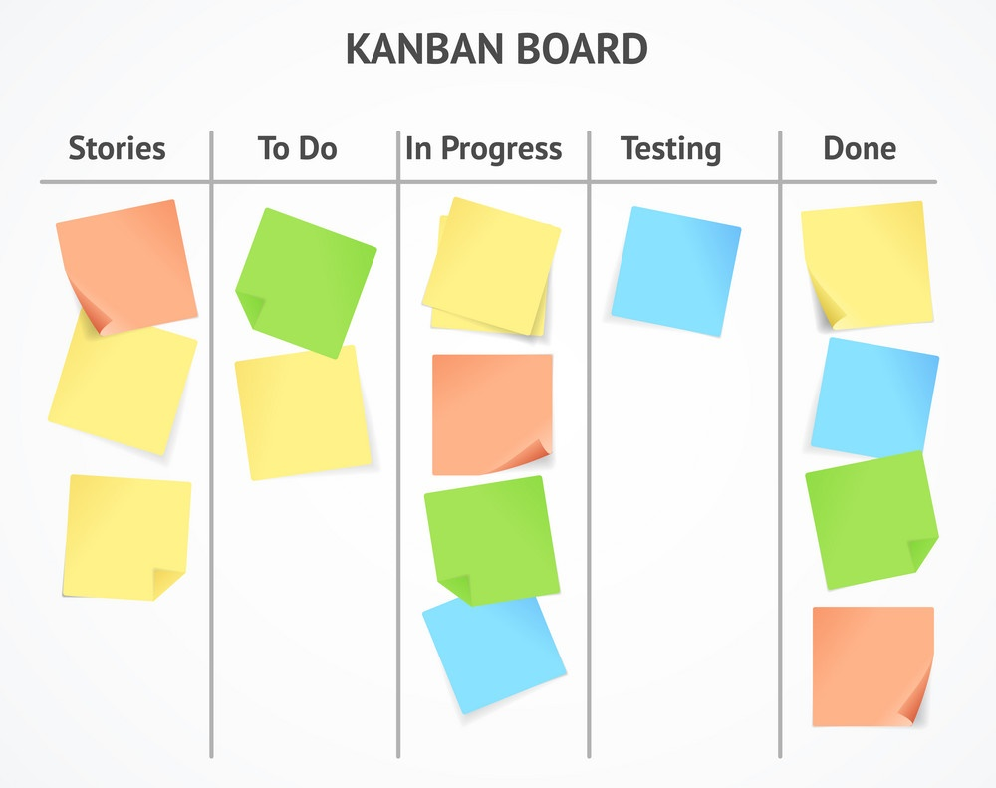
Kanban boards
To follow the progress of individual user stories, it's common to use task boards
These boards are often called kanban boards because of the agile process Kanban that uses them
Each row shows the progress of tasks related to the story on the left
People use physical boards with sticky notes or electronic tools like Trello
  Which you will be required to use in Project 3

Slide 17
Definition of done
What does done mean?
Team have their own versions of done, often with the following items:
  Design is complete and reviewed
  Code is formatted and commented
  Code has passed inspection
  Code has passed PBI acceptance criteria (tests)
  Code has passed all unit tests and regression tests
  User documentation has been updated
  Code has been integrated and passed all integration and systems tests
When a PBI is truly done, it's removed from the product backlog

Slide 18
Sprint review
At the end of a sprint, there is a sprint review to reflect on how the product is changing
All stakeholders are invited
Sprint review outline:
  Starts with the overall sprint goal and the PBIs in the sprint backlog
  Team lists the PBIs completed and explains why some didn't get done
  New aspects of the product are demonstrated
  Everyone discusses how to make the product better
Results of the review are used for planning the next sprint

Slide 19
Sprint retrospective
At the end of a sprint, there's also a sprint retrospective
Only the development team, including the PO and the SM, are invited
The retrospective is for analyzing how the team is working and how to improve
Improvements tend to be clear when a new team is working on a new product
  It may still take several sprints for an improvement to get fully integrated into the process
Over time, the team can become comfortable with the process, but finding improvement opportunities is still important

Slide 20
Other Scrum practices
Daily scrum: Short daily meeting, often called a stand-up (having no chairs encourages brevity)
  What did I do since the last meeting
  What will I do today
  What is impeding my progress
Story time: Groom the product backlog
Cross-functional teams: Get non-specialists to help with specialized tasks, to get the job done and expand skills
Sustainable pace: Don't overwork
Planning poker: Have team members contribute their time/work estimate for a PBI
Bidding: Team members bid on tasks with ideal hours
Pair programming: Two people sit together to code, with one typing (the driver) and the other checking (the navigator), switching off frequently

Slide 21
Review

Slide 22
Exam format
The exam will have:
  Short answer questions
  At least one diagram
  Two essay questions
Software Engineering is more … philosophical than some other CS courses
  And it's a Writing Intensive course

Slide 23
Managerial software engineering concerns
Managerial concerns are about organization and control
  Project cost
  Time estimation
  Scheduling and tracking
  Team management
  Risk management
  Quality

Slide 24
Technical software engineering concerns
Technical concerns are about what product, how to build it, and building it
  Software requirements
  Design
  Programming languages and environments
  Coding standards
  Defect prevention, detection, and removal
  Version control
  Documentation
  Maintenance

Slide 25
Questions when building software products
What exactly should it do? What if people disagree?
How does this product fit into the rest of the stuff the company does?
How will users interact with the product?
What parts should the product have?
What languages should it be written in?
What standards should we use to write it?
How do we know if the program does what it's supposed to?
How much time and money will it take to make it?
What kind of documentation will it need?
How will it change in the future?
How far along are we in the process of making it?

Slide 26
Management

Slide 27
Aspects of a project that must be managed
Scope
  How much the project is trying to accomplish
  Creep is the tendency for the work to increase
Time
  Must be reasonable for the project size
  Must be monitored
Cost
  Similar issues as with time
Quality
  How good is acceptable?
  Quality assurance must be done through the project, not just at the end
Resources
  Do you have the people (and tools) to get the job done?
Risks
  Have you planned for things going wrong?

Slide 28
Project management iron triangle
There's a graphical depiction of project management used imply relationships between time, scope, cost, and quality
This triangle is intended to indicate that you can't change scope, time, or cost without affecting the other two (at least if you want to maintain quality)
Increasing scope means increasing time or cost (or both)
It's obvious, but manager are sometimes tempted to push workers to work faster, for example, pretending there are no consequences
Scope
Quality
Time
Cost

Slide 29
Software development methods
Traditional methods
  Careful planning and hierarchical leadership
  Steps like requirement specification, design, implementation, testing, and maintenance
  Example: Waterfall model
Agile methods
  Constant iteration
  Self-directed teams
  Minimal documentation
  Example: Scrum
Both methods are widely used and many successful teams use aspects of both
The project for this class will mostly employ traditional methods because agile works best with experienced developers

Slide 30
Requirements and design
Requirements are functions or characteristics that software has
Customers or users determine the requirements
Stakeholder is a broad term that includes customers, users, developer, managers, and maybe the public
Designs specify how the software system will meet the requirements
Designs can look at a system from different aspects
Design patterns are standard solutions to problems that have been useful in the past and can help structure designs

Slide 31
Implementation
After the design is made, the software must be implemented in one or more programming languages
Compilers and interpreters are used to run the programs
Editors allow people to write code
Version control tools let people track the evolution of the code
Code checkers see if the code is meeting certain standards
Debuggers help programmers find mistakes

Slide 32
Version Control

Slide 33
Version control
For any large software project (and even small ones), it's valuable to have a way to track changes over time
Such tools are called version control systems
They allow:
  Changes to be tracked over time
  Developers to check code into repositories
  Comparison of files over time
  Documentation of changes made
It's more than just a glorified backup system

Slide 34
Repository
A repository is where all the development data is stored
  Usually called repos by professionals
Repositories include the current source code as well as a history of all the changes ever made
For source code, most version control systems use delta compression, meaning that only the differences between files are stored
Thus, hundreds of versions of your code can be stored without taking up hundreds of times the space

Slide 35
Actions
Committing a file is adding its changes to a repository
Cloning means creating a copy of another repository, including history
Merging is combining two sets of files with independent changes into one set with changes from both
Pulling (or fetching) copies the changes from an outside repository and adds them to the current repository
Pushing copies the changes from the current repository to an outside repository

Slide 36
Visualization of development
Tags
Trunk
Branches
Version control systems provide ways to organize the development process
One such feature is a visualization of the development process
The main sequence of development is called the trunk
Code bases that diverge from main development (to work on a new feature) are branches
Tags are snapshots of the code base in a particular state, often a release
Release 1
HEAD
Release 2
Discontinued

Slide 37
Popular version control systems
Git
  Git is one of the most popular systems with a distributed model
SVN
  SVN is one of the most popular systems with a client-server model
Microsoft Team Foundation Server
  Microsoft always has to have its own thing
Mercurial
  Mercurial competes with Git as a distributed VCS
Perforce
  A big suite of tools that can do its own things or integrate with Git
CVS
  An old client-server tool that was popular until SVN overtook it

Slide 38
Philosophy of Git
Git is a distributed VCS
Every computer has a complete history of all the changes, ever
There's no central server
Programmers make changes and push them to or pull them from other repositories
All operations are designed to be fast
Torvalds did a pretty good job, but some common tasks are confusing

Slide 39
Git process
Add
Commit
Push
Working Directory
Staging (Index)
Local Repository
Remote Repository
Reset
Fetch
Pull
It's all possible to reset to an earlier commit, overwriting the working directory, but it's confusing to put that arrow in.

Slide 40
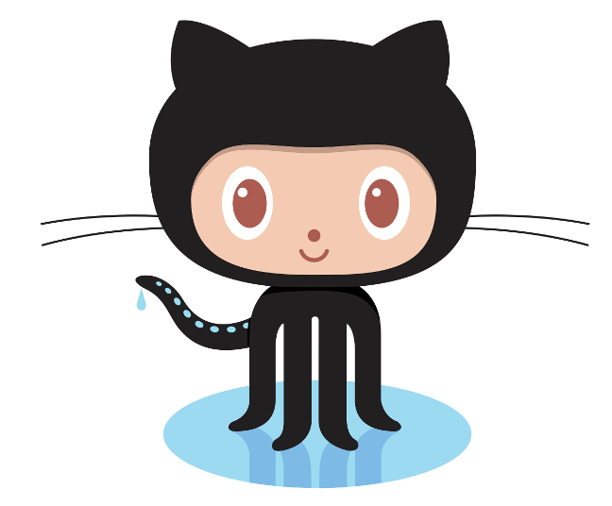
GitHub
GitHub.com provides online repositories for code
  Private repositories (except for education) are not free
  Public repositories are free
Git can be used without GitHub
GitHub can even be used without Git (since it has support for SVN)
GitHub has nice tools for:
  Visualizing who's committing and how much they have changed
  Issue tracking
  Writing commit information and Read Me files
  Pushing and pulling repos stored on GitHub
  Creating webpages related to releasing software
Ironically, Linus Torvalds hates GitHub

Slide 41
Requirements

Slide 42
Stakeholders
Stakeholders are anyone affected by a product or its development
  Customers are the people that pay for a product
  Users are people who interact with the product
  Clients are people for whom software was created (includes both customers and users)
  Developers are all the people who work on the project
  Regulators are responsible for ensuring that software meets standards
  Marketers stand in for clients when making mass-market products

Slide 43
Stakeholder needs
A stakeholder need is a feature that one or more stakeholders want
Sometimes, these needs are written in descriptions called needs specifications
Then, developers have to wrangle all of these conflicting, incomplete, and vague needs into a requirements specification
Traditional methods may have a specific person who does this
  Titles like requirements analyst, requirements specialist, user interaction designer

Slide 44
Functional requirements
It's common to divide requirements into functional and non-functional categories
Functional requirements are about how software takes input and turns it into output, its behavior
  Appearance
  User interface actions
  Input and output processes
Most requirements are functional requirements, and they take the most time and effort to specify

Slide 45
Non-functional requirements
Non-functional requirements describe the properties software must have
  Speed of processing
  Amount of memory used
  How often failures can be permitted
  Level of security
  Ease of modification
  Cost of development
  Platforms the product must run on
Non-functional requirements are more abstract than functional requirements
Functional requirements are tied to specific pieces of code, but non-functional requirements are properties of the whole system

Slide 46
Levels of abstraction
Business requirements specifications are client objectives that must be met
  They are abstract descriptions of the product
  They might include deadlines or sales targets
  They're usually non-functional requirements
User-level needs and requirements are one step more concrete
  They describe tasks or goals that the product would allow a user to perform
  These tend to describe what the product does but not how
  Could be functional or non-functional

Slide 47
More levels of abstraction
Operational-level needs and requirements describe individual inputs and outputs
  These are more specific than user-level needs and requirements
  Example: The product must allow users to enter polynomial equations, trigonometric equations, logarithmic equations, and exponential equations, all of one variable.
Physical-level needs and requirements are about the appearance and formatting of the user interface
  These will describe what the product actually looks like (which might be several different descriptions if the same product works on a desktop and a phone)
  Example: The product must provide a text-box for equation input. The text box must display 50 characters and scroll vertically up to 800 lines.

Slide 48
Requirements in traditional processes
Most of the terminology we've been using comes out of traditional software development processes like waterfall
In that paradigm, requirements must be gathered first, followed by design, followed by implementation, testing, and maintenance
The requirements must be frozen so that the next steps can take place
Then, no one wants to change the requirements because you'll have to redo everything that comes after, which is expensive

Slide 49
Problems with requirements in traditional processes
It's really hard to figure out all the requirements before doing any coding and looking at prototypes
The world changes quickly, especially in technology, and people's desires change
Writing all the requirements takes a lot of work, creates large documents, and costs a lot of money
The waterfall process means that nothing is ready for a long time (often years) after the project starts, and some projects get canceled

Slide 50
Requirements in agile processes
Agile developers try not to write requirements at all
  But you have to start with something...
Stakeholder needs are turned into lists called product backlogs
A product owner adds to the product backlogs and prioritizes them
High priority items are chosen for each sprint, the agile term for a development iteration

Slide 51
How Scrum tries to make changing requirements cheap and easy
Delay choosing requirements as long as possible
  Stakeholder needs can be easily added or removed from the product backlog
  Requirements are set only for the product backlog items (PBIs) when they're implemented on a sprint
Delay refinement as long as possible
  PBIs are broken down until they're small enough and detailed enough for a single sprint
  User-level requirements are refined into operational- and physical-level requirements for the sprint where they're implemented
Avoid writing requirements altogether
  Instead of writing down physical-level requirements, talk to the stakeholders and implement what they say in the sprint
Determine requirements in light of current product features
  Because agile methods iterate on an existing product, everyone can see which features would be most useful next

Slide 52
Stating specifications in traditional processes
Specifications are usually made in declarative English (or appropriate natural language) sentences
Problem: English is vague and confusing
Rules for good technical writing:
  Write complete, simple sentences in the active voice
  Define terms clearly and use them consistently
  Avoid synonyms
  Group related material into sections
  Use tables, lists, indentation, white space, and other formatting aids
Use "must" or "shall" to describe behaviors the product must do

Slide 53
Testable requirements
Requirements should be testable or verifiable
This means that there can be a process for testing whether the product meets the requirement
Bad requirement:
  The product must display query results quickly.
Good requirement:
  The product must display query results in less than one second.
The bad requirement isn't testable because "quickly" is subjective
The good requirement is testable because we can time the finished system

Slide 54
Requirements traceability
We want a clear relationship between a requirement, a part of the design, the code that implements this design, and the tests that verify it
Being able to connect the requirements to later stages of development is called requirements traceability
To make requirements more traceable, each specification should state only a single requirement
  This kind of specification is called atomic
Non-atomic specification:
  The product must display a list of previous commands and the results of commands, each in its own window.
The goal is simplicity and clarity
A long list of simple requirements is better than a short list of confusing, complex requirements

Slide 55
Stating specifications in agile processes
Agile developers have some documents like product vision statements and product backlog items
A very common way to describe requirements is through user stories
A user story describes a function that the product provides to users
Sometimes a big story that is a huge chunk of the application is called an epic
Sometimes a story that would take several sprints to implement is called a feature
A story that can be implemented in a single sprint is a sprintable story or an implementable story
Note: Some agile people only use the term user story for sprintable stories

Slide 56
User voice form
A common way of expressing user stories is user voice form:
  As a <role>, I want to <activity> so that <benefit>.
  <role> is replaced by a user role, which is some category of user
  <activity> is a function that the system does
  <benefit> shows the value of the activity but is an optional part of user voice form
Example:
  As a payroll clerk, I want to enter salary data so that payrolls will use adjusted salaries.

Slide 57
Eliciting stakeholder needs in traditional processes
It can be difficult to discover what stakeholders actually want from a product
Some approaches:
  Interviews: Ask individual stakeholders what they want and record the answers
  Observation: Watch the users doing tasks, asking them to describe the actions they're taking
  Focus groups: Informal discussion with six to nine people and a facilitator
  Workshops: A meeting focused on documenting the desires of many stakeholders
  Prototypes: Let stakeholders respond to different version of a product
  Document studies: Read documents associated with the business that needs the product
  Competitive product studies: Analyze similar existing products for strengths and weaknesses

Slide 58
Eliciting stakeholder needs in agile processes
Agile processes don't focus on getting all the requirements up front
Instead, a cornerstone of the agile approach is constantly getting feedback, allowing for quick responses
The product itself becomes an evolving prototype that it easy to understand and unlikely to become obsolete
Potential problems:
  Stakeholders can overreact to current problems and lose sight of the big picture
  Agile methods give a lot of power to the few stakeholders who give feedback, and others might be ignored

Slide 59
Requirements management in traditional processes
Projects start with a product mission statement giving business requirements
Requirements analysis is the process of gathering stakeholder needs and using them to turn the mission statement into a list of requirements specifications
The result is a document called a software requirements specification (SRS)

Slide 60
Requirements management in agile processes
The mission statement or other high-level needs are used to writer big user stories
Working with stakeholders, the team refines sprintable stories into operational-level and physical-level requirements
The product owner has the responsibility to update the product backlog as the product evolves

Slide 61
Requirements modeling
When software engineers say modeling, they usually mean drawing diagrams
Requirements modeling is making representations (diagrams) that help you understand your requirements
Both traditional and agile processes use models
The Unified Modeling Language (UML) is the most common set of standards for representing such models
Some developers use model extensively, and others use them rarely

Slide 62
Kinds of requirements modeling
Model | Show | Typical UML Diagram
Use Case Models | A product interacting with its environment, often actors who take on roles | Use Case Diagram
Conceptual Models | Relationships between entities | Class Diagram
State Diagrams | The states a product can be in and the transitions between those states | State Diagram
Decision Trees and Tables | What a product should do under various conditions | Activity Diagram
Data Flow Diagrams | How data enters, is processed, and leaves the product | Activity Diagram or Sequence Diagram

Slide 63
UML

Slide 64
Modeling
At both the requirements stage and the design stage, modeling can be useful
Modeling mostly means drawing boxes and arrows
We want high-level descriptions of:
  What the thing is supposed to do
  What parts it's composed of
  How it does what it does

Slide 65
System modeling
Models leave out details
Models are useful to help understand a complex system
  During requirements engineering, models clarify what an existing system does
  Or models could be used to plan out a new system
Models can represent different perspectives of a system:
  External: the context of a system
  Interaction: the interactions within the system or between it and the outside
  Structural: organization of a system
  Behavior: how the system responds to events

Slide 66
UML
The Unified Modeling Language (UML) is an international standard for graphical models of software systems
A few useful kinds of diagrams:
  Activity diagrams
  Use case diagrams
  Sequence diagrams
  State diagrams
Class diagrams are important enough that we'll talk about them in greater detail

Slide 67
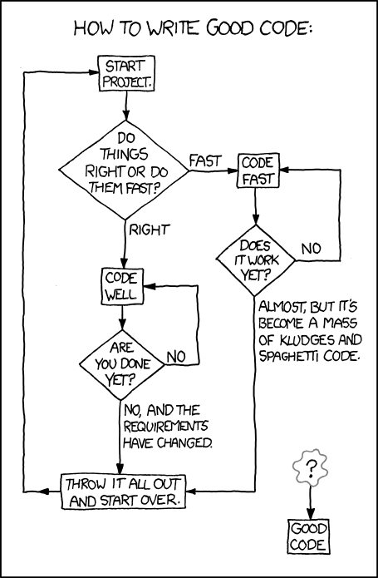
Activity diagrams
Activity diagrams show the workflow of actions that a system takes
XKCD of an activity diagram for writing good code
  From: https://xkcd.com/844/
Formally:
  Rounded rectangles represent actions
  Diamonds represent decisions
  Bars represent starting or ending concurrent activities
  A black circle represents the start
  An encircled black circle represents the end

Slide 68
More detailed activity model

Slide 69
Data-driven modeling
Data-driven models show how input data is processed to generate output data
The following is an activity diagram that shows how blood sugar data is processed by a system to deliver the right amount of insulin

Slide 70
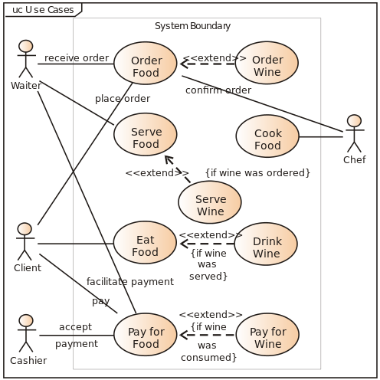
Use case diagrams
Use case diagrams show relationships between users of a system and different use cases where the user is involved
Example from Wikipedia:

Slide 71
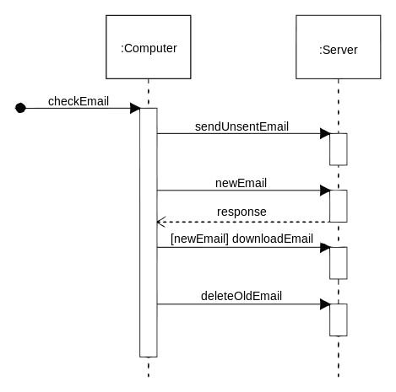
Sequence diagrams
Sequence diagrams show system object interactions over time
These messages are visualized as arrows
  Solid arrow heads are synchronous messages
  Open arrow heads are asynchronous messages
  Dashed lines represent replies
Example from Wikipedia:

Slide 72
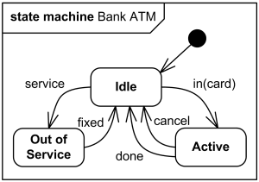
State diagrams
State diagrams are the UML generalization of finite state automata from discrete math
They describe a series of states that a system can be in and how transitions between those states happen
Example from uml-diagrams.org:

Slide 73
Event-driven modeling
Event-driven modeling is another kind of behavioral modeling that focuses on how a system responds to events rather than on processing a stream of data
Here's a state diagram for a microwave oven based on various outside events

Slide 74
Structural models
Structural models show how a system is organized in terms of its components and their relationships
UML class diagrams are used for structural models, but they can be used in many different ways:
  Relationships
  Generalization
  Aggregation

Slide 75
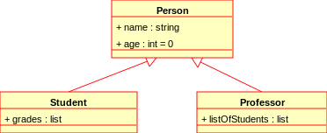
Class diagrams
Class diagrams show many kinds of relationships
The classes being described often (but not always) map to classes in object-oriented languages
The following symbols are used to mark class members:
  + Public
  - Private
  # Protected
  / Derived
  ~ Package
  * Random
Example from Wikipedia:

Slide 76
Relationships
Associations between classes can be drawn with a line in a class diagram
Notations can be used to mark relationships as one to one, many to one, many to many, etc.
These kinds of relationships are particularly important when designing a database

Slide 77
Generalization
Classes can be listed with their attributes
However, there are often classes that share attributes with each other
Some classes are specialized versions of other classes, with more attributes and abilities
This relationship between general classes and more specialized classes is handled in Java by the mechanic of inheritance

Slide 78
Aggregation
Another way of using class diagrams is to show that some objects or classes are made up of smaller parts represented by other classes
A diamond shape is used to mark a class that is the whole, and its parts are connected to the diamond

Slide 79
Software Processes

Slide 80
Software processes
A software process is a process used to make or support software
A software lifecycle process shows the steps from product inception to retirement of the product
A model is an entity used to represent another entity (the target)
A software process model is a model for a software process
  Usually a 2D diagram like a UML diagram

Slide 81
Waterfall lifecycle model
Product
Vision
Requirements
SRS
Design
SDD
Implementation
Code
Testing
Software Product
Rounded rectangles are actions (tasks)
Squared rectangles are documents (data)
Maintenance

Slide 82
More on waterfall
Developers get a product vision
From it and interaction with stakeholders, they create a software requirements specification (SRS)
From the SRS, they create a software design document (SDD)
Using the SDD, they implement the code
Then they test the software product
When the software is in use, problems are found, leading to maintenance and a new release
The name "waterfall" is because each action flows to the next
  Like a series of waterfalls
In principle, developers never return to an earlier action
In practice, earlier actions must always be reexamined because you never get it perfect the first time
Even so, the goal is to be a thorough as possible the first time

Slide 83
Advantages of waterfall
The whole product is specified
The project to create it is planned early
This approach is important for large and complicated products from a management perspective
  Size, cost, delivery dates, etc.
By comparing to the plan, it's easy to tell if a product is on-time and on-budget
If it isn't, managers can take actions
  Increase time, increase budget, reduce scope, etc.

Slide 84
More advantages of waterfall
If each step is done completely and correctly, all mistakes are found before moving on to the next step
  This ends up being the major disadvantage of waterfall, too, since mistakes usually propagate to future steps
Good documentation is created for each step
  This is really important when new people are added to the project
Each phase is distinct, allowing it to be carried out by teams that specialize in that phase
  For multiple projects, appropriate teams can be scheduled for maximum efficiency

Slide 85
Disadvantages of waterfall
Requirements can't change
  But they usually do
  If requirements change, all the advantages of waterfall's predictability disappear too
Even when requirements stay the same, it's hard to be complete and consistent in documenting them
Creating all the documentation for waterfall is expensive
If you have separate teams for each phase, each team has to learn what has already been done

Slide 86
More disadvantages of waterfall
Because there are so many teams, a lot of management is needed
  Drives up the cost
  Heavyweight processes are ones with a lot of documentation and management
There's no product until completion of the entire project
  Could take years
  We don't realize the problems until the product is available
  Clients might not want the product anymore

Slide 87
To waterfall or not to waterfall?
Waterfall was the only process for a long time
Its track record isn't great
  Success only about 25% of the time historically, but the rate is improving
Waterfall only works when the requirements are stable
Waterfall has a lot of overhead
  Might be justified for large projects
  Isn't justified for small projects
Use waterfall only for large projects with stable requirements or when there are very high safety, security, or reliability requirements

Slide 88
Prototyping
A prototype is a working model of a finished product
  It can model a part or the whole
Prototypes can help offset problems with the waterfall model
Prototypes are particularly helpful with testing out UI decisions
Prototypes are easy(ish) to make and change
  Try out several!
  See which one is the better design
Throwaway prototypes are just used for making specifications and then thrown out
Evolutionary prototypes are modified into the final product

Slide 89
Prototyping process
Product
Vision
Prototypes can be used within the waterfall model
Or they can be used for an entirely prototype-based lifecycle model:
This idea is what incremental and agile processes are built around
Design
Implementation
Prototype
Demo and Evaluation
Software Product
Complete
Incomplete

Slide 90
Advantages of prototyping
Changes to specifications are easy to handle
Customers are more likely to get what they want (since they get regular opportunities for feedback)
Customers can get (potentially) useful software quickly
Not much documentation or management is needed
  Lightweight development process

Slide 91
Disadvantages of prototyping
Without the planning of a process like waterfall
  It's hard to predict a reasonable deadline for the final product
  It's hard to predict the budget
Product design might be bad since the product evolved without following a plan
  The biggest problem here is maintainability: How can new features be added?
An undisciplined process can have poor quality control
  The product might be unreliable or buggy

Slide 92
Risk management
A risk is an event with negative consequences
  Losing source code
  Losing a team member
  Finding an unexpected design flaw
  Underestimating the time needed to write a piece of code
Business people think about risk a lot
Risk management is identifying, analyzing, controlling, or mitigating risks
Risk management should be incorporated into all software lifecycle processes

Slide 93
Spiral model
The spiral model is built around risk management
Multiple cycles are used
Each cycle starts by looking at goals
Then evaluate different approaches to the goals in terms of risk
The model on the right shows how the spiral model can be applied to waterfall

Slide 94
Iterative and Incremental Processes

Slide 95
Iterative and Incremental Processes
An iterative process contains repeated tasks
  Example: While debugging code, you might run tests, do fixes, run tests, do fixes, and so on
An incremental process produces output in parts
Processes can be either iterative or incremental, both iterative and incremental, or neither
The purest version of waterfall is neither
  It's not iterative because each phase is separate and not repeated
  It's not incremental because a working product is only available at the end

Slide 96
Iterative processes
Iteration is the main way you get quality
  It's just so hard to get it right the first time!
  Software development still involves significant trial and error
Even the waterfall model usually has iterative steps in practice
Prototype evolution is iterative
The spiral process is iterative
The problem with iteration is rework
  Redoing or throwing out previous work

Slide 97
Incremental processes
Iteration is found lurking everywhere to greater or lesser degrees, but being incremental is more binary
To be incremental, final products must be produced along the way
Waterfall is not incremental because the products produced along the way are just used for the next step

Slide 98
Rational Unified Process
The Rational Unified Process (RUP) is a process that is both iterative and incremental
Pure RUP is now rarely used, but it was a step in the evolution of modern agile methods
RUP creates products in increments called releases made during a cycle
  Each release is a working product
Each cycle has four phases: inception, elaboration, construction, and transition
Each phase has iterations divided into five workflows: requirements, analysis, design, implementation, and test

Slide 99
Agile
Versions of waterfall were the only commonly used software development model until the 1990s
A lot of people were unhappy with it
In response, some developers created the Agile Manifesto, a statement about developing software that was diametrically opposed to waterfall
The ideas caught on, and many developers embraced the idea, creating a series of different methods
Sometimes businesses claimed to be changing over to agile methods but really just renamed parts of their waterfall approach

Slide 100
Agile manifesto
We are uncovering better ways of developing software by doing it and helping others do it. Through this work we have come to value:
Individuals and interactions over processes and tools
Working software over comprehensive documentation
Customer collaboration over contract negotiation
Responding to change over following a plan
That is, while there is value in the items on the right, we value the items on the left more.

Slide 101
Agile characteristics
The ideas caught on, spawning specific methods such as Extreme Programming, the Crystal Method, Dynamic System Development Method, and Scrum
These methods all have the following characteristics:
  Incremental process with increments ranging from a week to a few months
  Customers are closely and continuously involved in the product
  Lightweight process minimizing documentation and management tasks
  Test driven, using automated test suites to avoid the problems of frequent code change

Slide 102
Agile lifecycle
Product
Vision
Refine Specifications
Agile processes are similar, following a lifecycle much like the one on the right
Create Increment
Deliverable Product
Evaluate Increment
Improve Process
Realization
Released
Not Released

Slide 103
Agile advantages
Product specifications can change without destroying all the work that's been done
Customers get a software product quickly
  With new versions coming frequently
Bad projects can be canceled early
Time is saved because of lightweight requirements for documentation and management
Duplication of effort is usually reduced

Slide 104
Agile disadvantages
Customers have to be involved constantly, but most customers don't want to spend their time giving feedback
Continuous refinement of a product can lead to a bad design through an evolution of ideas that seemed like a good idea at the time
For large projects, it's hard to coordinate many teams on a product that is evolving unpredictably without documentation
It's hard to predict the outcomes of agile methods

Slide 105
Scrum

Slide 106
Scrum process
Create Product Backlog
Product
Vision
Product Backlog
Like other workflows, Scrum can be modeled with an activity diagram showing familiar steps
Everything is built around a cycle called a sprint
Because sprints repeat, the process is iterative
Because each sprint produces a shippable product, the process is incremental
Sprint Planning
Sprint Backlog
Sprint Execution
Sprint Backlog
Product Backlog
Shippable Product
Sprint Review
Product Backlog
Sprint Retrospective
Project Not Done
Project Done

Slide 107
Sprints
Recall that agile methods are built around a product backlog, containing high-level descriptions of the desired features of the product
  Items can be added to or removed from the product backlog at any time
Some of the product backlog is chosen for a sprint
  Making the sprint backlog
The sprint backlog is implemented, making a new shippable product
A sprint review allows customers to give feedback on the product
The sprint retrospective is used to figure out how to do the next sprint better

Slide 108
Scrum roles
Product owner (PO)
  Responsible for what's in the product
  Customer representative to the other developers
  Updates the product backlog
Scrum master (SM)
  Guides the team through the Scrum process
  Facilitator and coach
  Protects the team from outside interference
Team members
  People who decide how to build the project and build it
  Typically, everyone works on everything

Slide 109
Scrum artifacts
Product backlog
  A prioritized list of product features that haven't been implemented yet
  Product backlog items (PBIs) are the elements of this list
  Priorities are based on business value
Sprint backlog
  Subset of PBIs
  Tasks needed to complete them
  Estimates of effort needed for each one
Potentially shippable increment (PSI)
  Product that could be shipped to the customer (though maybe without all the desired features)
  A PBI on the sprint backlog that wasn't finished goes back into the product backlog

Slide 110
Scrum activities
Product backlog creation
  The PO creates the product backlog for the first time, using customer input
Product backlog refinement
  The PO constantly adds and deletes PBIs from the product backlog based on feedback from stakeholders
Sprint planning
  The PO, SM, and other team members select PBIs, maybe with a particular sprint goal
  PBIs are chosen by priority, taking into account how much can be done by estimating the work for the tasks for a PBI
Sprint execution
  Everyone performs the tasks to implement the sprint backlog PBIs
Sprint review
  A product demo where stakeholders discuss what was added and how they feel about it
  Goal: improving the product
Sprint retrospective
  The team discusses what went well, what didn't, and how the next sprint can be better
  Goal: improving the process

Slide 111
Managing the product backlog
The product backlog is a prioritized list of PBIs
Each PBI consists of
  Specification
  Priority
  Estimate of effort
  Acceptance criteria

Slide 112
PBI priorities
In addition to the specification of functionality, every PBI should have a priority
Priorities express how important the PBI is and can be expressed as a number or a rubric (low, medium, high, critical)
The PO sets the priorities based on stakeholder feedback
Dependencies also determine priorities: If X is needed for Y, then the priority of X must be at least as high as Y
High-priority PBIs should be small enough to do in a single sprint

Slide 113
PBI effort estimates
Each PBI must have an effort estimate
High-priority, sprintable PBIs need precise estimates (such as person-days), to aid in sprint planning
Low-priority, abstract PBIs are further from sprintable status and only need rough estimates (small, medium, large, gigantic)
As PBIs are refined, their effort estimates need to become more precise

Slide 114
PBI acceptance criteria
How do we know when a PBI is done?
Acceptance criteria are checks a user can do to see if a PBI is finished and correct
Often, these form a test suite used by developers
Following the same pattern of steady refinement, high-priority PBIs should have detailed acceptance criteria
  These acceptance criteria might be further refined during the sprint

Slide 115
Product backlog refinement
Refining or grooming the product backlog means:
  Adding, removing, or modifying PBIs
  Making PBIs nearing the top of the product backlog more detailed
  Re-estimating and re-prioritizing PBIs
  Adding acceptance criteria to PBIs
Refinement happens during sprint review
It should happen at least once during a sprint to make sure there are enough sprintable stories for the next sprint
A PO can use a spreadsheet to manage the product backlog, but there are also specialized tools

Slide 116
Estimating work and timeline
Two pieces of information are needed: The size of the job and the speed of the team
PBIs are estimated by story points or ideal hours
One or two story points is supposed to be how much effort the smallest stories take
  Bigger stories are estimated relative to that size
An ideal hour or a person hour is the amount an average developer can accomplish in one uninterrupted hour of work
Story points are more commonly used, since they're easier to estimate

Slide 117
Velocity
Velocity is the amount of work done per sprint
After a sprint, story points or ideal hours can be added up to see how much got done
Past velocities can be used as a guide for how many story points can get done when planning the next sprint
Ideally, tracking this information will help get better estimates of story points and ideal hours for other stories and also a better estimate of team velocity

Slide 118
Sprinting
Sprinting is actually doing the implementation
Sprinting is considered a time-boxing technique, where the amount of work done is based on the time available
  Rather than letting time expand as needed to finish a task
For a given project (and at a given company) sprints are usually the same length, somewhere between a week and a month
Short, consistent sprints are easier to plan and track and give rapid feedback
If PBIs can't be finished during a sprint, they go back on the product backlog
If a team finishes all PBIs before the sprint is over, they can get another one from the PO

Slide 119
Burn charts
Burn charts can be used to track progress on a project
  Burn-down charts show how much work is left and are preferred for sprints
  Burn-up charts show how much work has been done
A burn-down chart shows the total effort in story points on the y axis and time on the x axis
A straight line shows ideal progress while real progress is plotted against it

Slide 120
Kanban boards
To follow the progress of individual user stories, it's common to use task boards
These boards are often called kanban boards because of the agile process Kanban that uses them
Each row shows the progress of tasks related to the story on the left
People use physical boards with sticky notes or electronic tools like Trello

Slide 121
Sprint review
At the end of a sprint, there is a sprint review to reflect on how the product is changing
All stakeholders are invited
Sprint review outline:
  Starts with the overall sprint goal and the PBIs in the sprint backlog
  Team lists the PBIs completed and explains why some didn't get done
  New aspects of the product are demonstrated
  Everyone discusses how to make the product better
Results of the review are used for planning the next sprint

Slide 122
Sprint retrospective
At the end of a sprint, there's also a sprint retrospective
Only the development team, including the PO and the SM, are invited
The retrospective is for analyzing how the team is working and how to improve
Improvements tend to be clear when a new team is working on a new product
  It may still take several sprints for an improvement to get fully integrated into the process
Over time, the team can become comfortable with the process, but finding improvement opportunities is still important

Slide 123
Quiz

Slide 124
Upcoming

Slide 125
Next time…
Work day on Friday

Slide 126
Reminders
Exam 1 is next Monday
  Review Chapters 1-3 and 5
Finish the final version of Project 1 for Friday

